Slide 1
YouTube advertisement insights for marketers
Raj Parikh, Krishna Nambi

Slide 2
Motivation
Youtube is a video sharing platform that allows users to create and upload video blogs(vlogs) with different types of video content.
It is one of the dominant social media platforms that attracts billions of viewers per day all around the world
Youtube artists or content creators have captured considerable share of the entertainment market and are considered as Influencers or Youtube Celebrities
Providing a new medium for various companies to advertise their products and services and have better outreach

Slide 3
Project Scope
Identifying appropriate YouTube channels for brand advertisements and better market reach
Analyzing the youtube community and identifying the popular genres dominating the market
Analyzing the parameters to evaluate youtube channels for collaboration
Analysis of the budding YouTube channels for exploring new business partner relations
Identifying the top youtube channels and analyzing the frequency of their video uploads

Slide 4
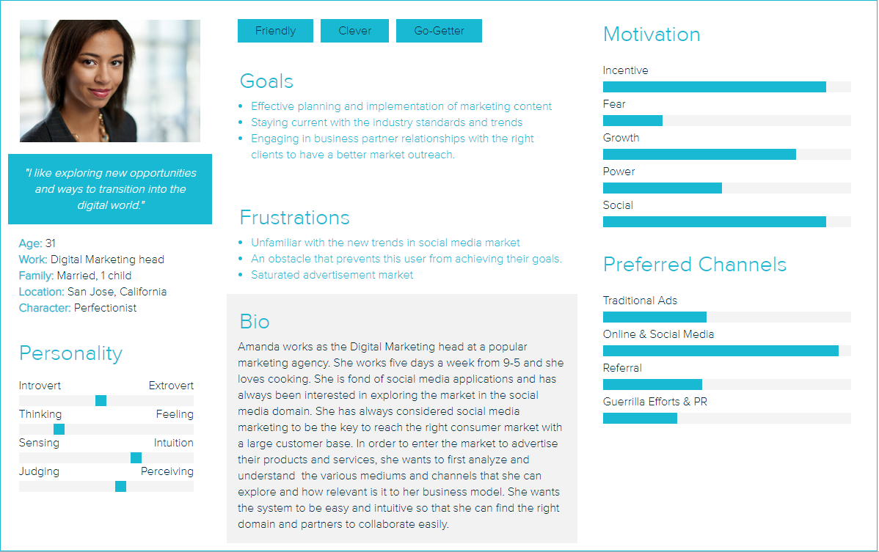
Target Audience
Source : Xtensio.com

Slide 5
Data Collection
Identified API’s for collecting data
Registered for key and authenticated our application
Collected list of top 1200 channels
Collected data for channels using YouTube data API
Collected revenue details for the channels
Sources
https://developers.google.com/youtube/analytics
https://influencermarketinghub.com/youtube-revenue generation/
Notes:
The various data fields extracted from the API and the web application includes Channel Title, Region, Subscriber Count, Number of Views over the videos, Number of videos uploaded, Genre, Monthly and Yearly Channel Earnings, Rating, Number of likes, Number of dislikes, channel description, Channel ID and Number of Comments for each YouTube channel.

Slide 6
Data preparation
Converted records with missing values for likes, dislikes and comments section to zero value
Converted salary data to standard-format
Represented rank as ordinal values
Identified possible outliers using z-test and replaced its salary value with predicted regression value
Notes:
extracted

Slide 7
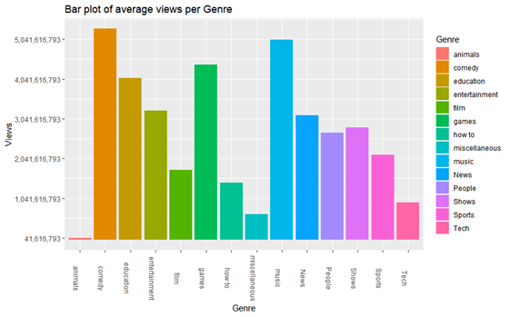
Analyzing trends in Genres
Analyzed trending genres based upon number of views
Performed anova analysis to confirm observation
Notes:
Performed exploratory and inferential analysis to understand current trends in more depth
Visually analyzed trending genres based upon views. Certain genres had higher views than other.
Performed anova analysis to confirm the result that the findings are significant. With views as dependent and genre as categorical variable
4.7*10^-3

Slide 8
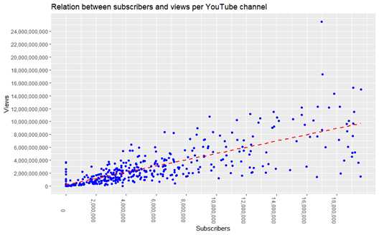
Relation between subscribers and views
Analysis of the relationship between subscribers and number of views
Identified growing youtube channels using ratio of subscribers/views
Notes:
The ratio between views to subscribers to identify growing Youtubers. The idea is that , growing youtubers start getting lot of views overnight but as they were not very popular before certain videos there subscribers are relatively less. Performed z-test to identify any youtube channel having eccentric ratio, currently no channels out of top 1200 had such high ratio.

Slide 9
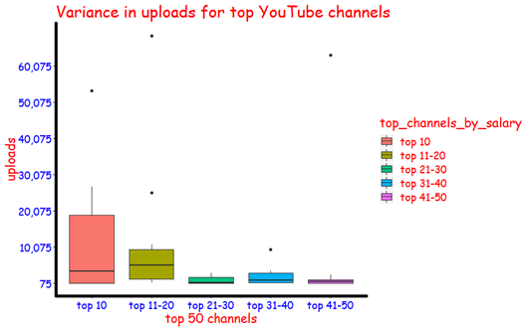
Salary range of top YouTube Channels
Analysis of upload frequency of top earning YouTube channels with the help of box-plots
Notes:
Finally we analyzed how frequently top youtube channels upload so that we can get a slot on their videos to place ads. It was observed that some of the top youtube channels have very high number of uploads and thus we can place ads on these channels were the charge is comparatively less as compared to other videos

Slide 10
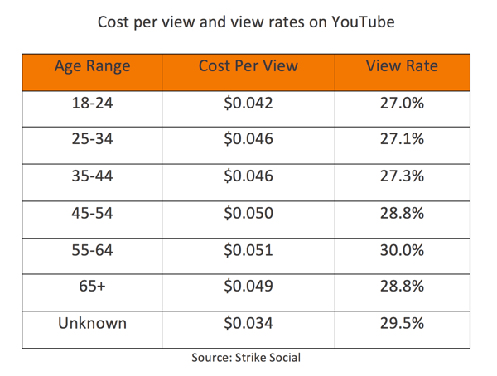
Conclusion
Viewers Accept Ads on YouTube More Readily Than on other social media platforms
Large groups of Youtube content consumers in our dataset with no demographic information- Is it a positive side ?
Youtube channels with less subscribers but more views can be identified as growing youtube channels ?

Slide 11
Conclusion
How can the advertising and digital marketing agencies benefit from the analysis?
Influential factors that make these youtube genres popular?
Limitations if any?

Slide 12
THANK YOU!
Any questions?
Krishna Nambi
Raj Parikh

